Slide 1
CitiBike Proposal

Slide 2
Table of contents
01
Introduction
02
Analysis
03
Solutions
05
Appendix
Our Motivations
COVID-19’s effect on CitiBike and MTA
How CitiBike can respond to COVID-19
04
Future Work Ideas
Extras
What’s next?

Slide 3




01
Introduction
Our Motivations
Notes:
Motivation is to investigate the level of disruption the public transportation industry is experiencing in NYC due to COVID-19, and

Slide 4
Motivations
Investigate the level of disruption in the NYC public transportation industry during the COVID-19 crisis
Compare the relative levels of decline in demand experienced by MTA & CitiBike
Provide recommendations for CitiBike

Slide 5
02
Analysis
COVID-19’s effect on CitiBike and MTA

Slide 6
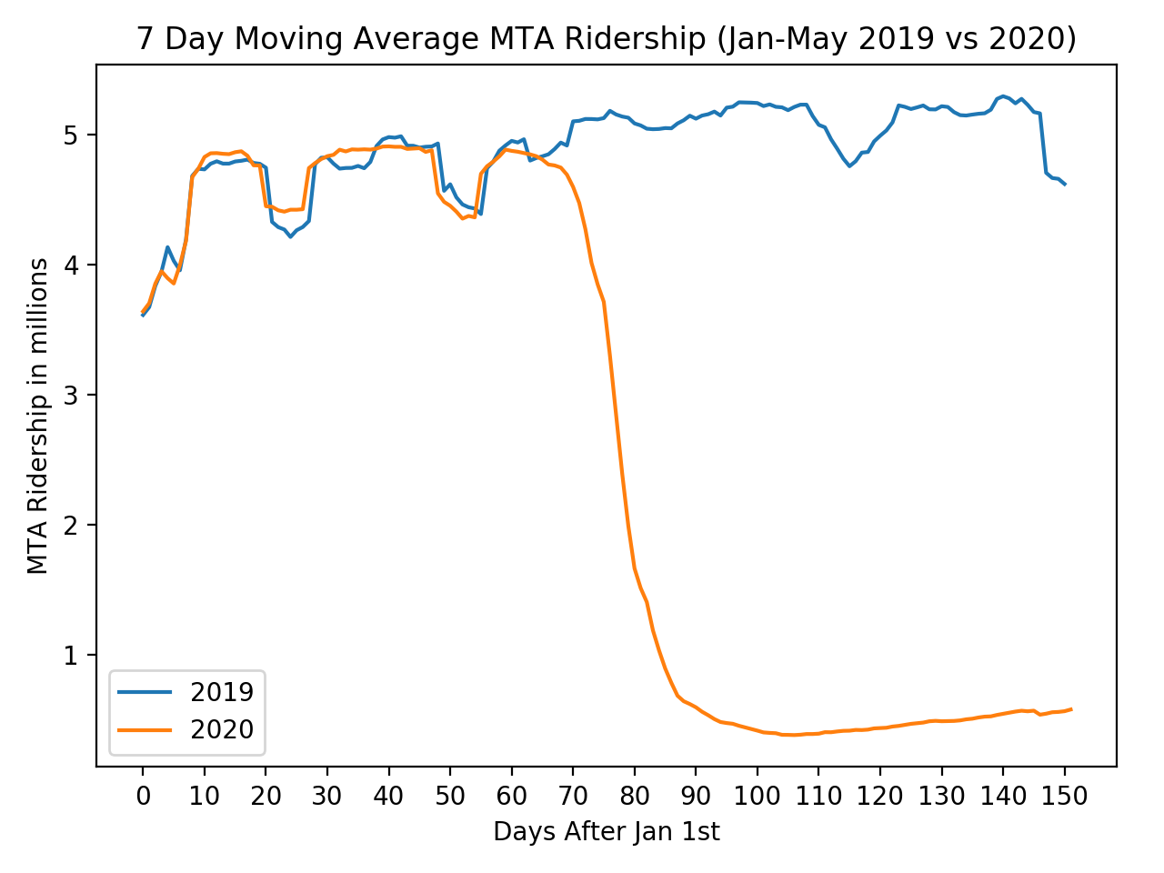
Effects of COVID-19 on MTA Ridership
Notes:
-look at effects - 7 day rolling average of MTA ridership in 2019 vs 2020, smooth out for fluctuations during the week
- 70 days in, mid-march, see steep decline (when state of emergency was announced)
- by april, ridership plateaus to about 10% of historical ridership in 2019

Slide 7
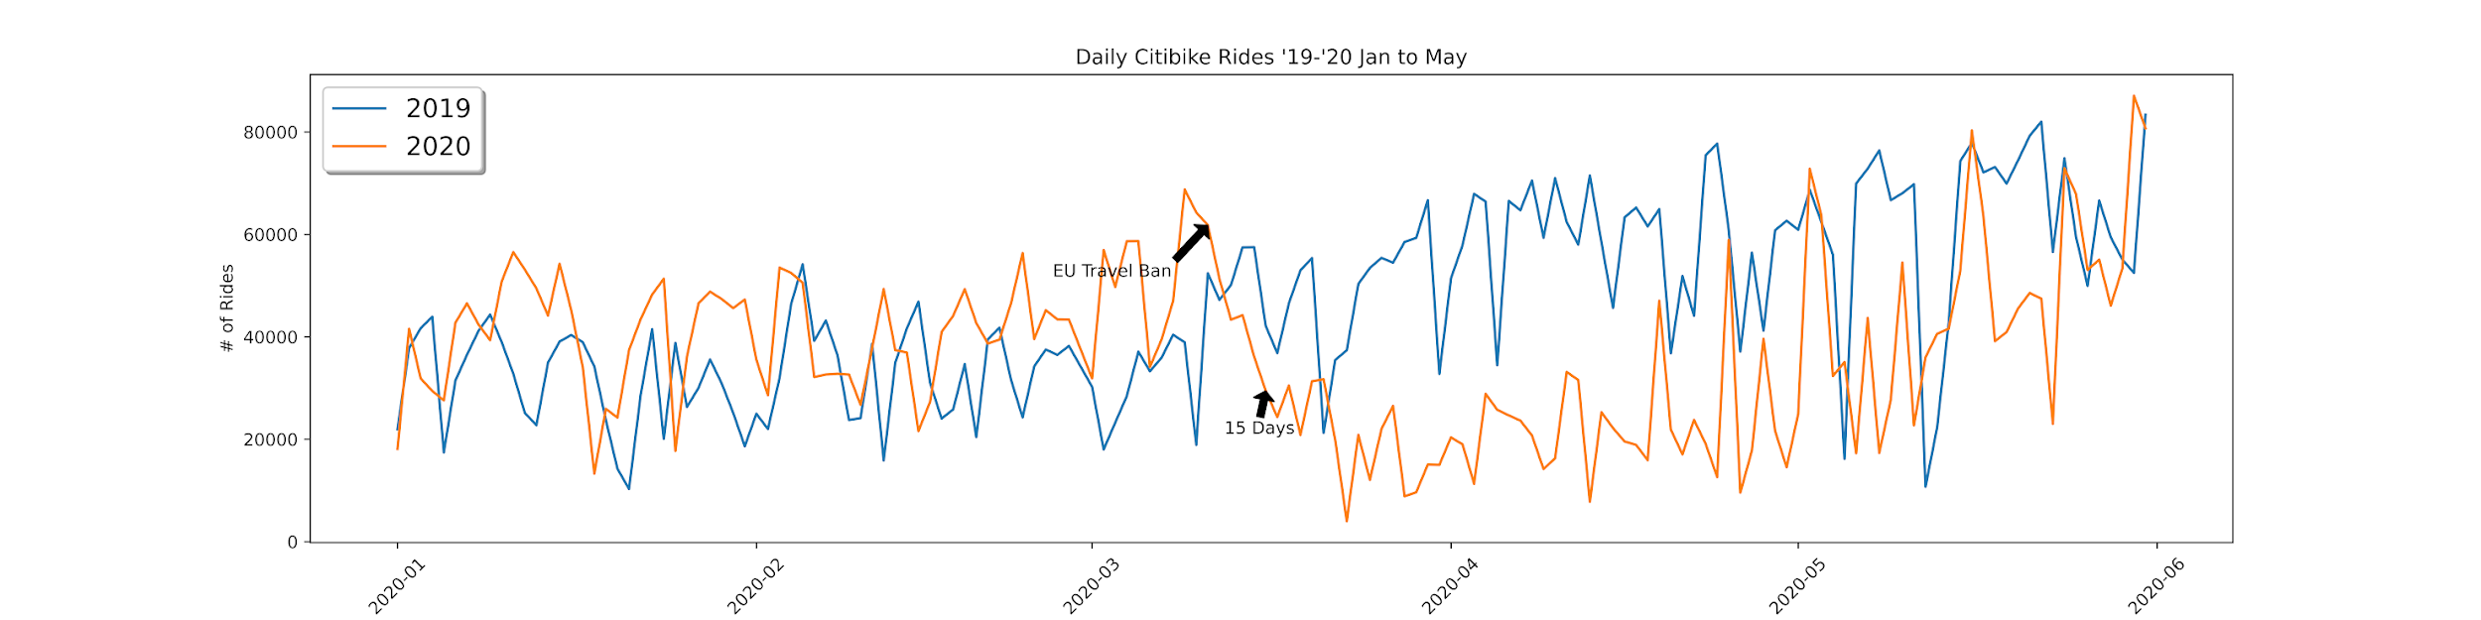
Effects of COVID-19 on CitiBike Ridership

Slide 8
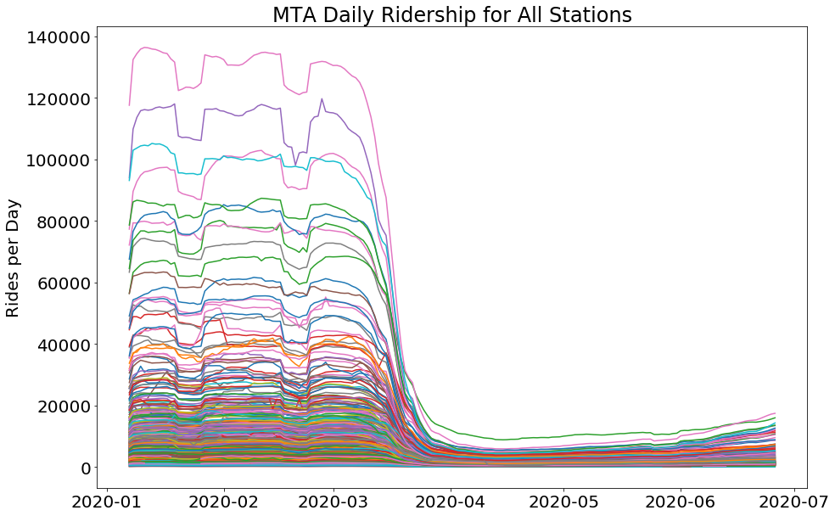
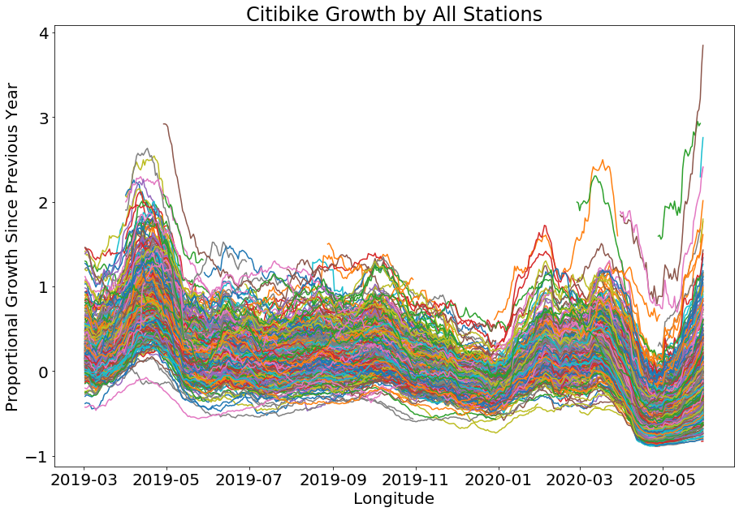
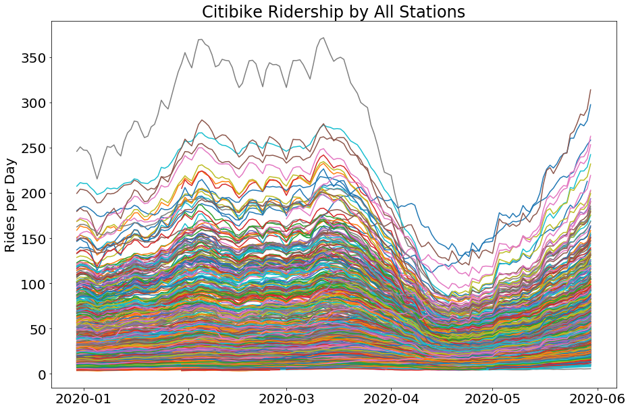
Dramatic, sustained reduction in MTA ridership
Gentler, and short-lived reduction in Citibike ridership
Citibike rapidly growing into the summer
Notes:
The NYC subway system is old and established. It’s been a part of New Yorker’s routines for generations, so seeing such a dramatic and sustained reduction in ridership is a huge deviation from what would be expected in the absence of COVID-19. Citibike is much smaller and newer, fairly consistently growing in ridership over time. It’s volatile in general, due to weather and human events, but it appears to have weathered COVID-19 much better than the MTA so far. Despite having declined in the summer of 2019, Citibike ridership is increasing rapidly following the end of the COVID-19 lockdown. Some stations are still depressed, but others have considerably higher ridership than the same time last year.

Slide 9
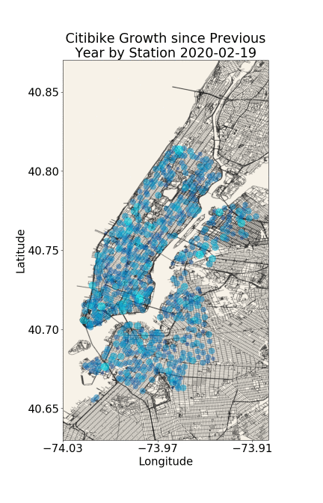
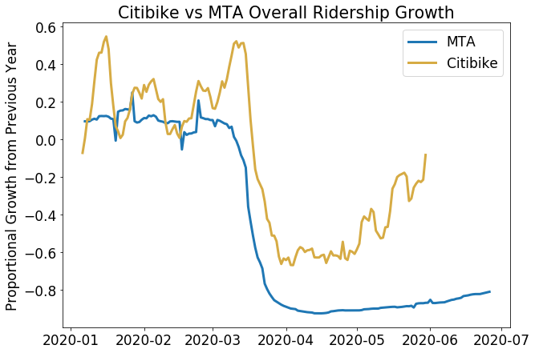
Overall Citibike recovery much faster than MTA
Particular post-COVID growth in Chelsea, the Garment District, and Brooklyn Heights
Notes:
Plotting the overall ridership annual growth rate compared to the MTA, we can confirm that the total system-wide ridership was less affected and is recovering much faster.
In the scatterplot over the map of NYC, we can see that the entire system was dramatically depressed over the month of April, but now stations are seeing growth again. Considering that the growth has a concentration in the middle of Manhattan, where the MTA has seen its steepest declines, we suspect that the bikes are being used by people who would have taken the subway absent COVID-19. They’re forming habits that may be sticky even the end of COVID-19 precautions.

Slide 10
03
Solutions
How CitiBike can respond to COVID-19

Slide 11
three steps to take
IDENTIFY MOST AFFECTED MTAs
FIND CLOSEST BIKE STATIONS
IMPLEMENT CUSTOMER PROMOS AT BIKE STATIONS
Notes:
Now that we know how much COVID- 19 affects the MTA and CitiBike. How does Citibike respond to the corona virus?
-First , Then. , After
-first time customer discount, having a mobile cleaning unit at these locations

Slide 12
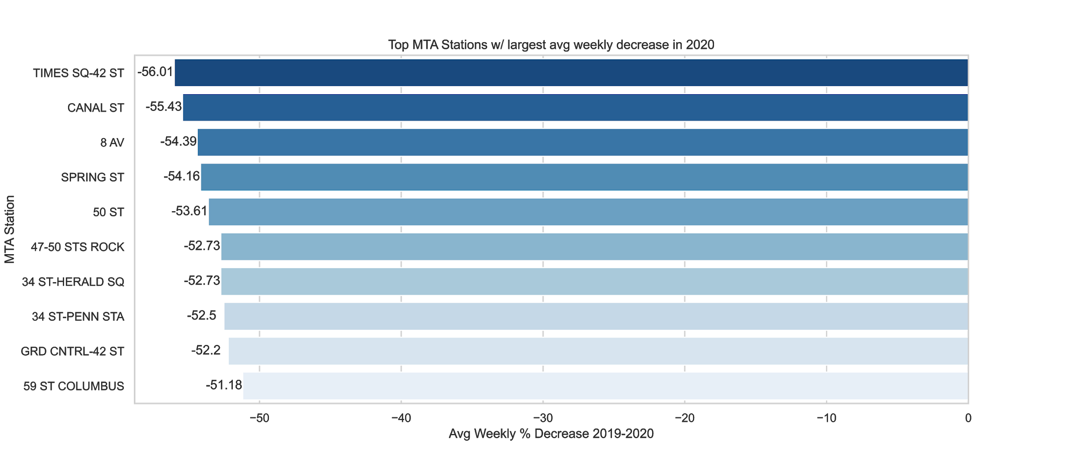

Top MTA Stations with the largest avg weekly % decrease in 2020
Notes:
The most affected MTA stations from 2019 2020 avg weekly decrease, Grand Central. Our reasoning is that Citibike can capture a portion of the market lost from MTA.

Slide 13
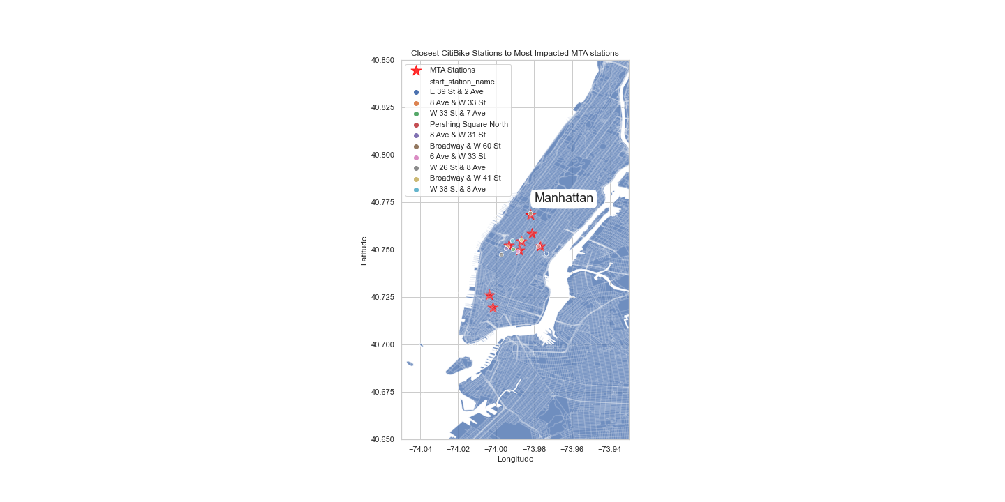

CitiBike Stations closest to most impacted MTA stations
E 39 St & Ave
8 Ave & W 33 St
Pershing Square North
Broadway & W 60 St
Notes:
After we identify the most impacted MTA stations in Manhattan , we find the CitiBike stations that are are closest to MTA stations. These are examples of bike stations that we can do promottions on.

Slide 14
04
Future Work Ideas
Incorporate tourism data
Consider direction of Citibike trips
Incorporate new ridership data as it becomes available

Slide 15
05
Appendix

Slide 16
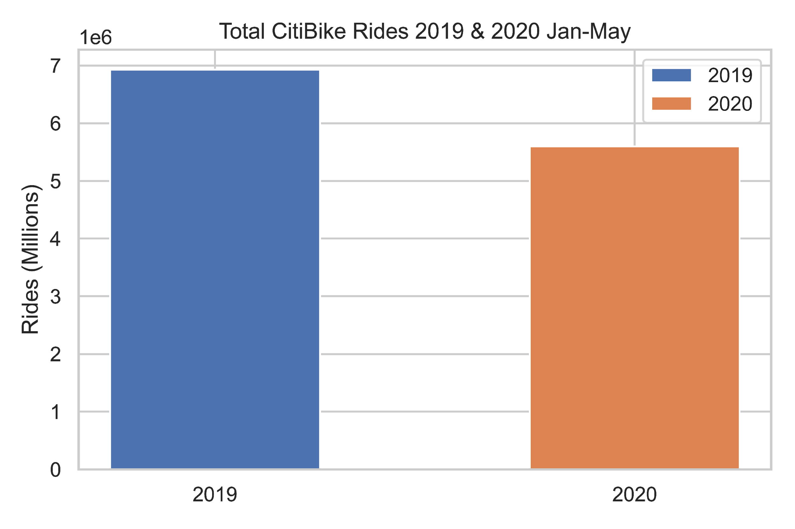
Total CitiBike Rides 2019 / 2020 Jan-May(millions)

Slide 17
Total Daily CitiBike Rides 2019 / 2020 Jan-May

Slide 18
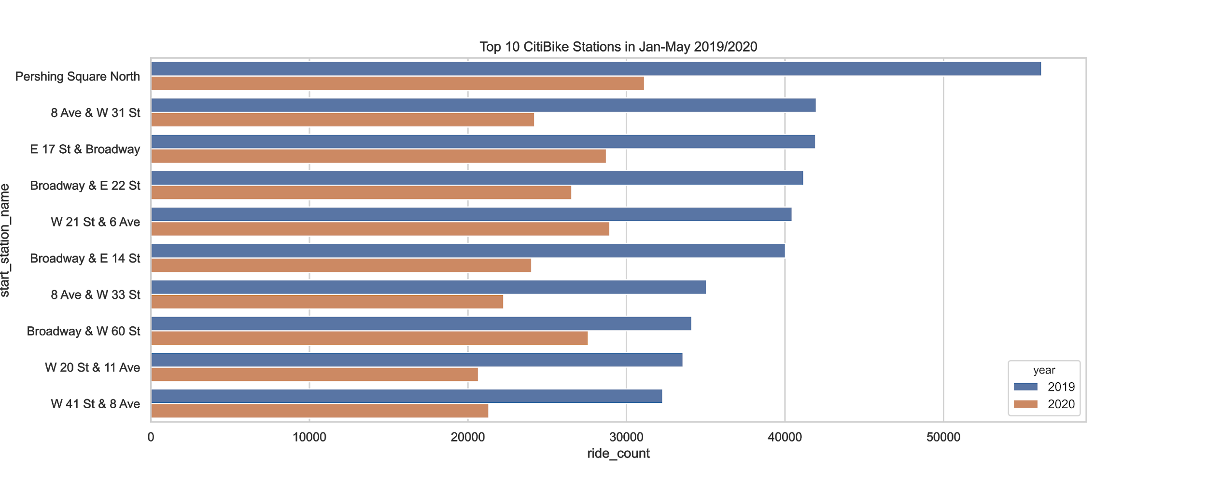
Top Ten CitiBike Stations Jan-May 2019 /2020

Slide 19
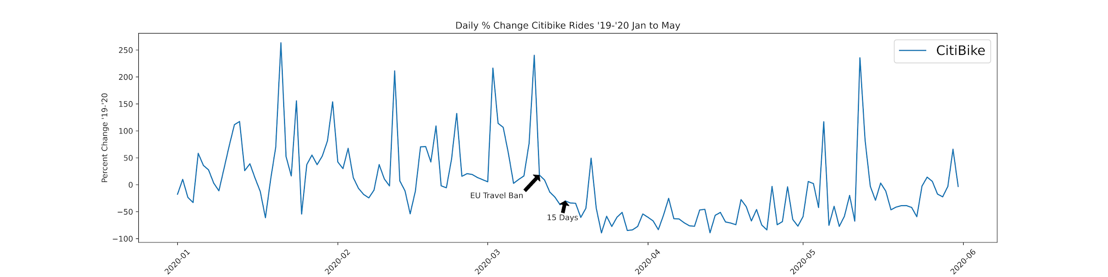
% Change Daily CitiBike Rides 2019 / 2020 Jan-May

Slide 20
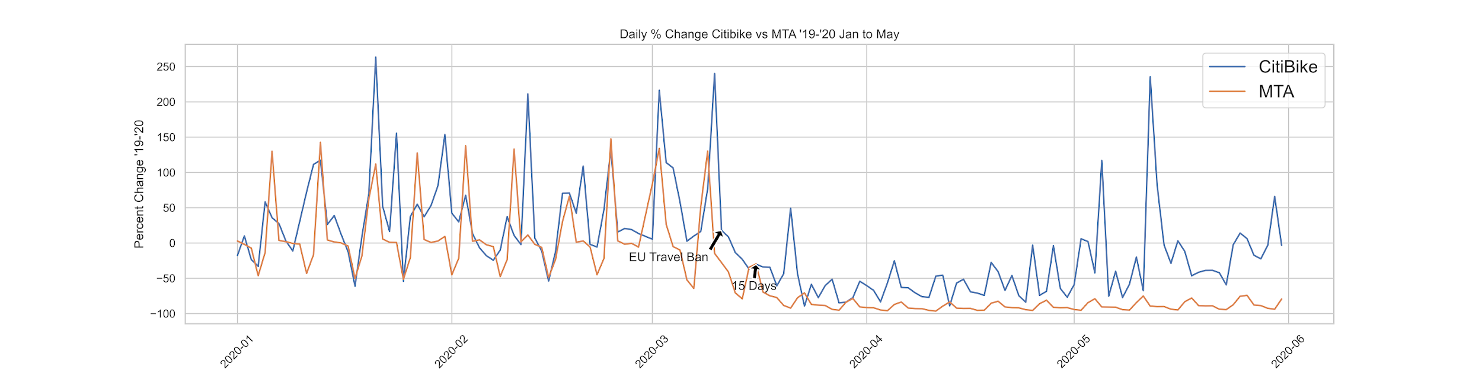
% Change Daily CitiBike & MTA Rides 2019 / 2020 Jan-May

Slide 21
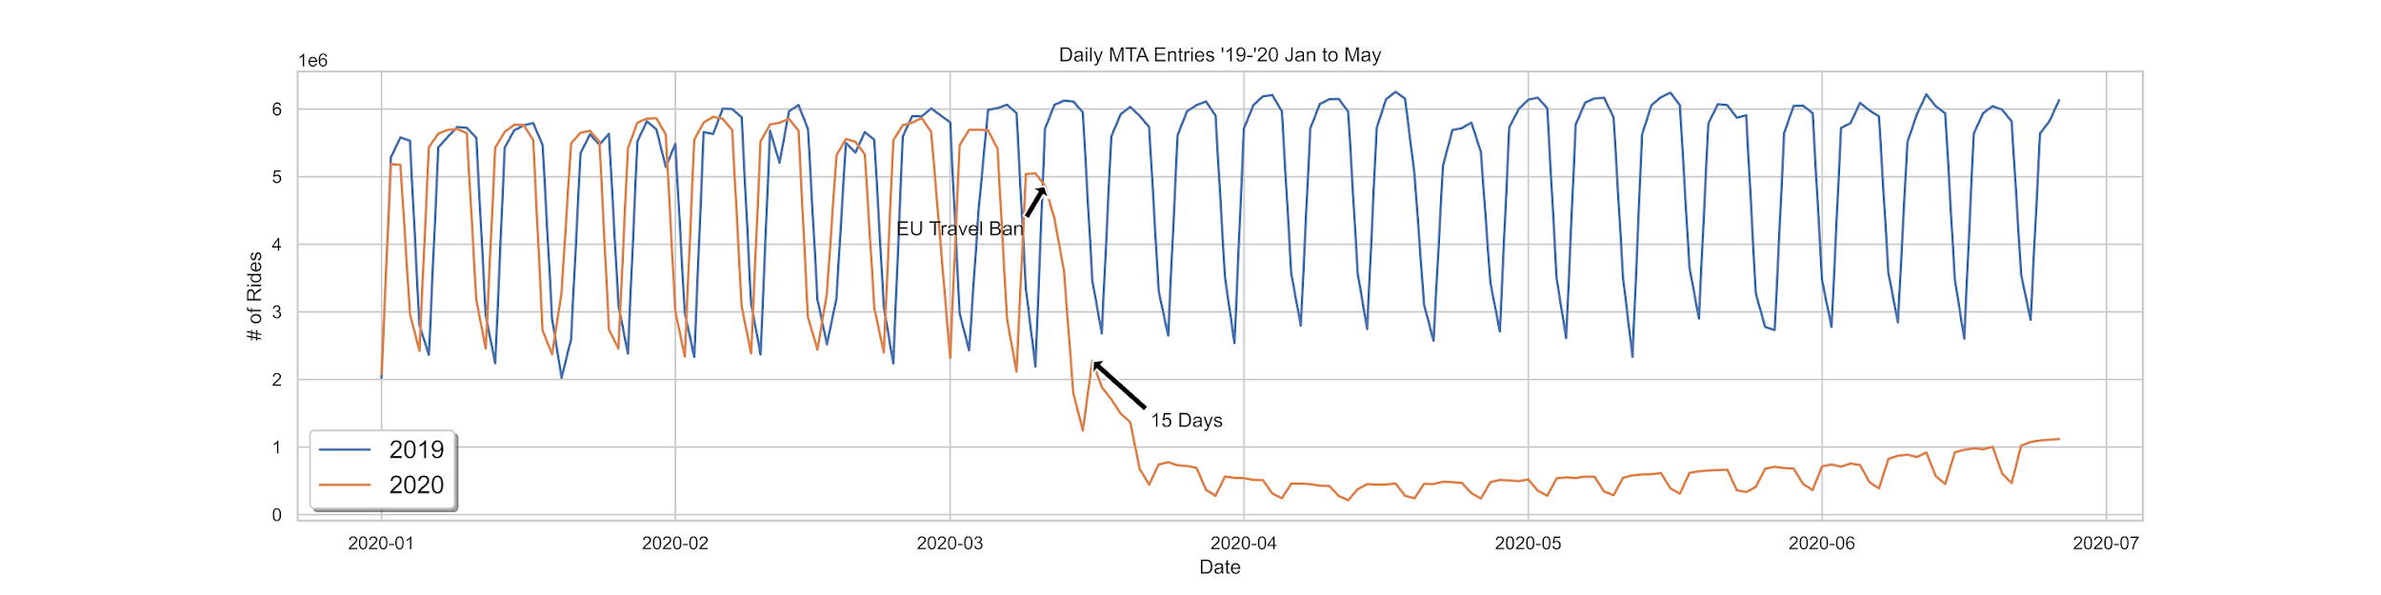
Daily MTA Entries 2019 / 2020 Jan-May

Slide 22
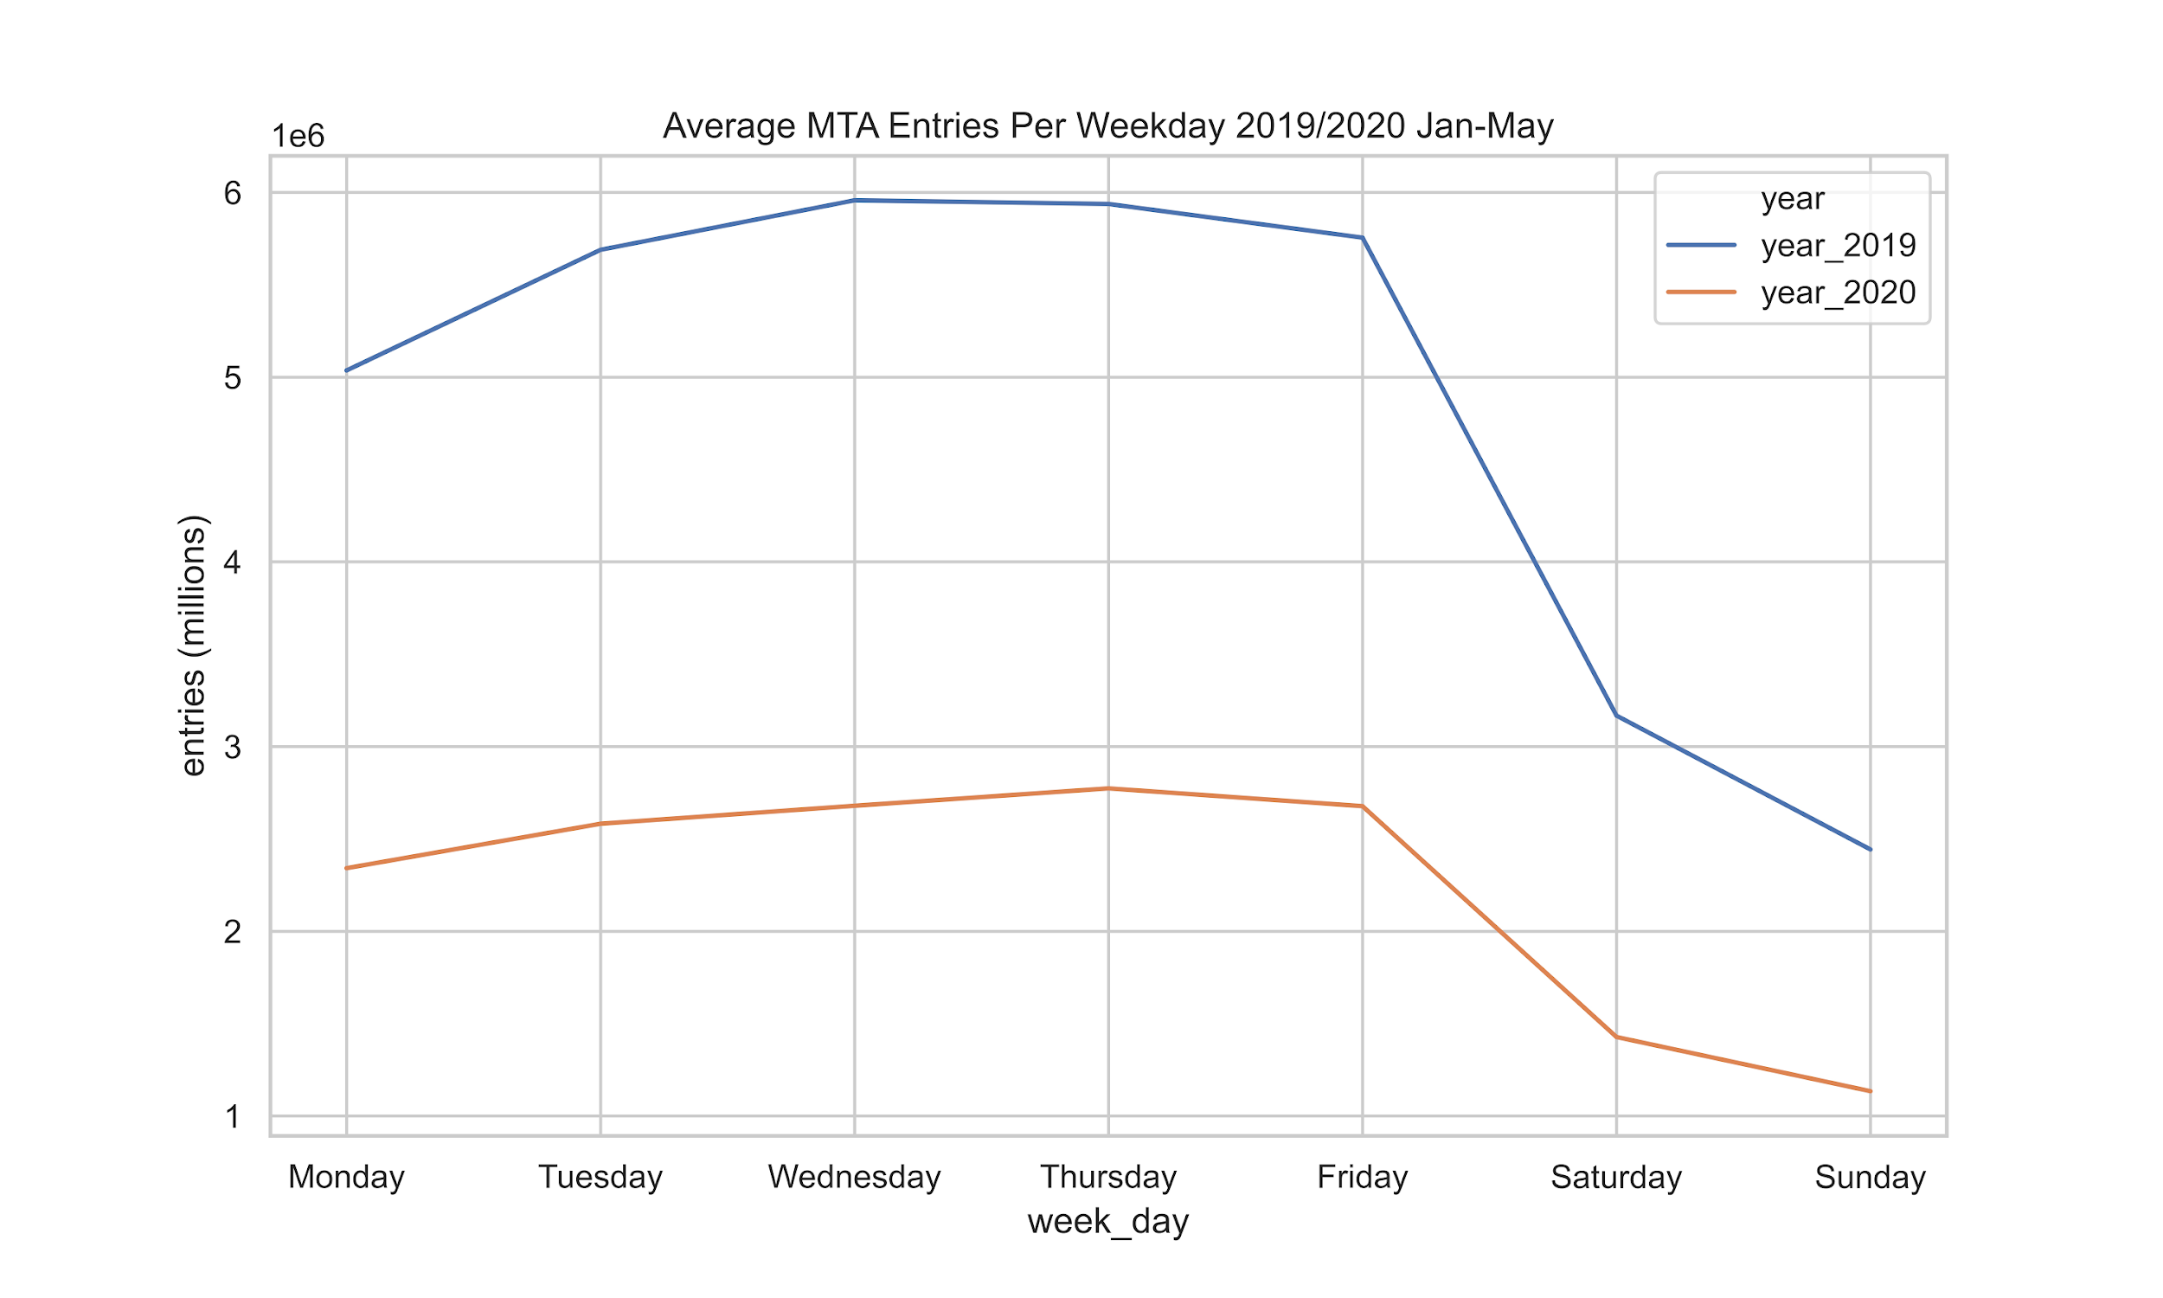
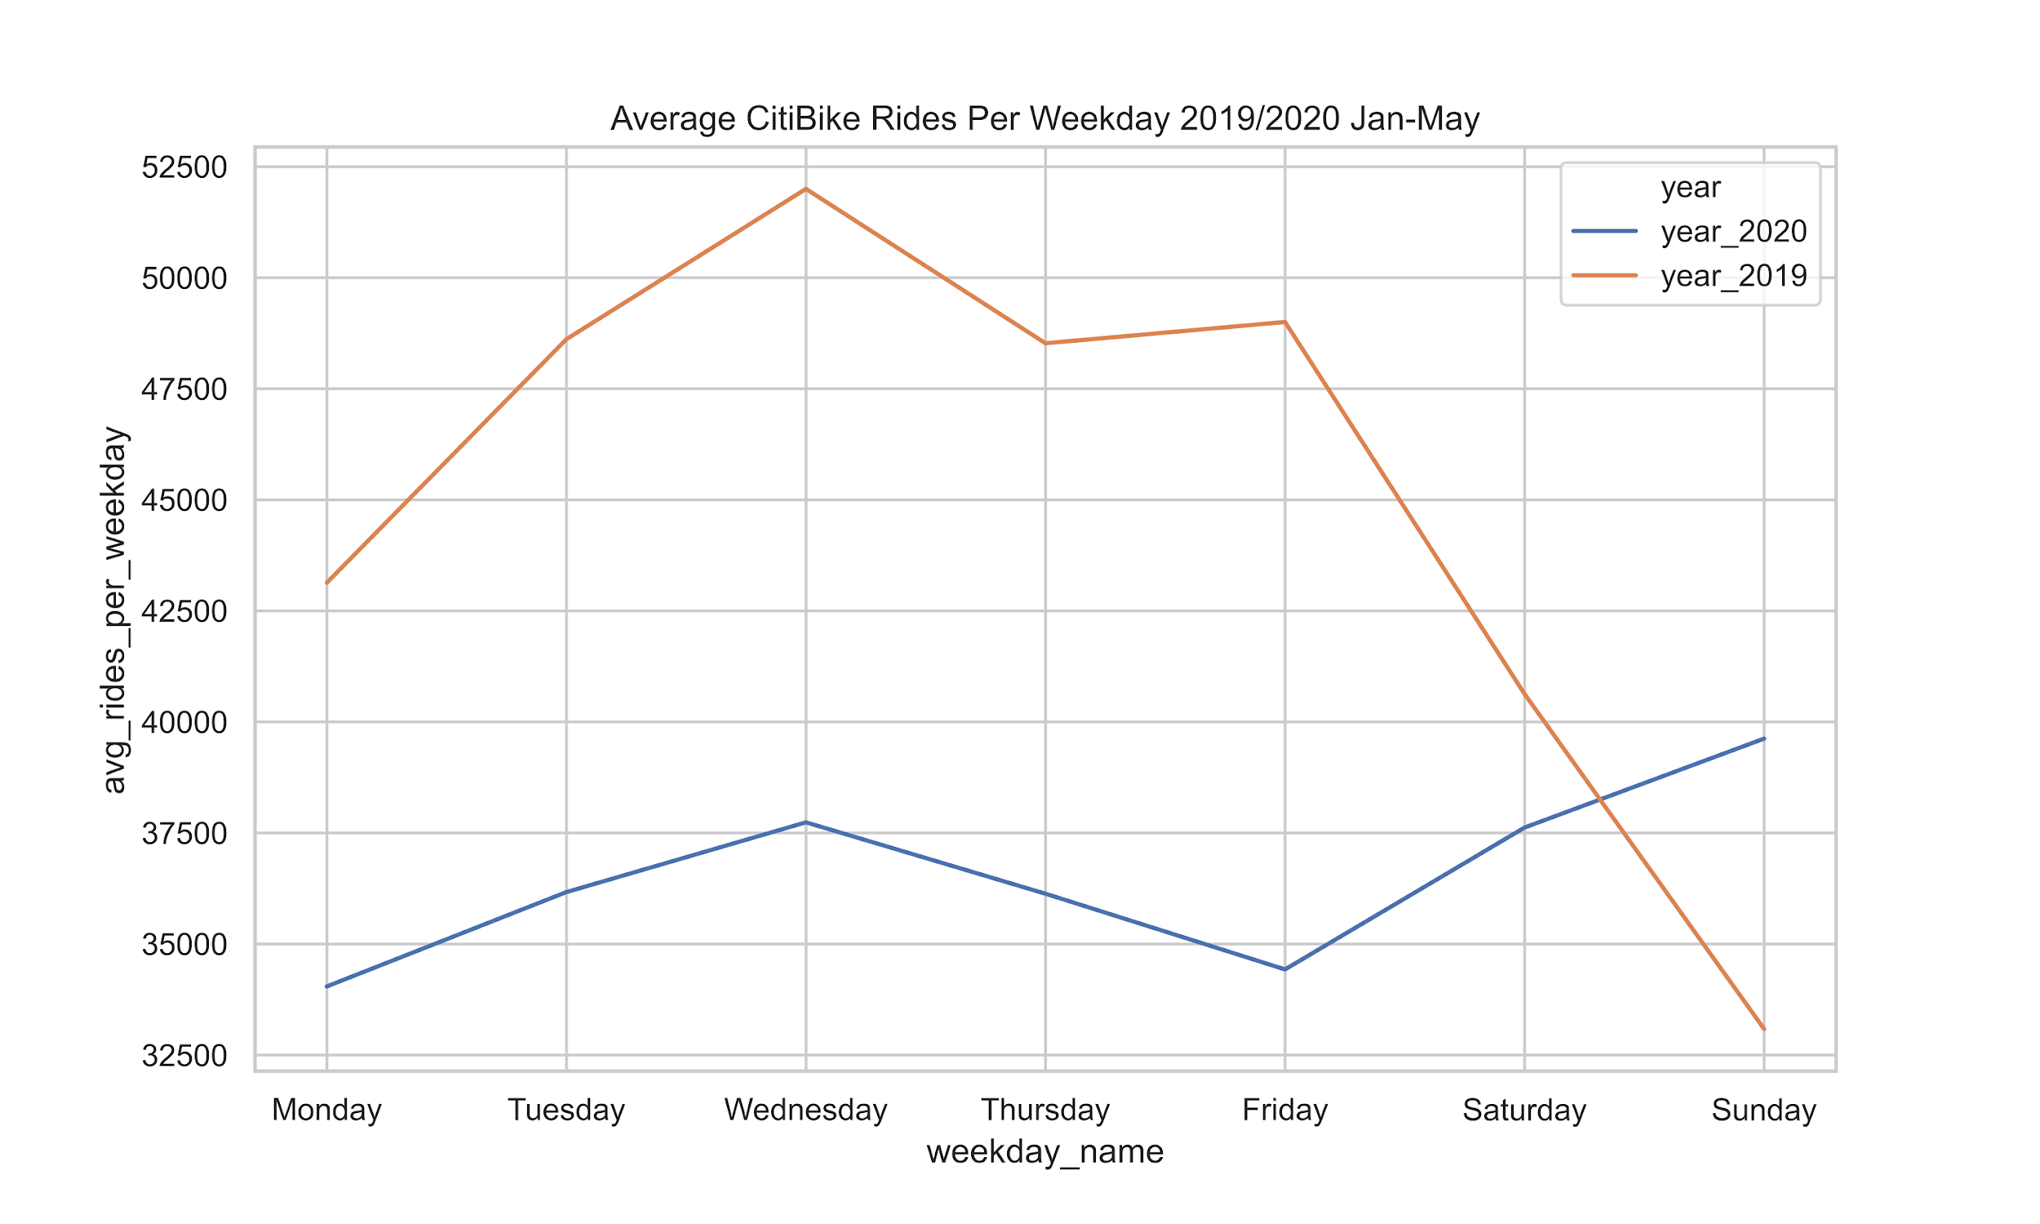
Avg rides per weekday MTA & CitiBike 2019 / 2020 Jan-May

